Slide 1

Visual Builder Studio

Slide 2
Agenda
Visual Builder Cloud Service
Visual Builder Studio
Visual Builder Platform Architecture
Benefits of VB Studio
Cost
Summary

Slide 3
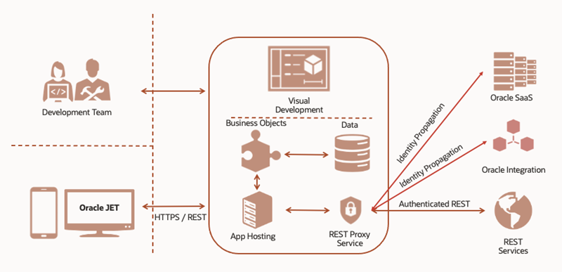
Visual Builder Cloud Service
An intuitive development experience on top of a development and hosting platform that empowers you to create engaging responsive applications
Rapidly create and host enterprise using a visual development environment.
The development tool for Oracle Cloud Fusion Apps

Slide 4
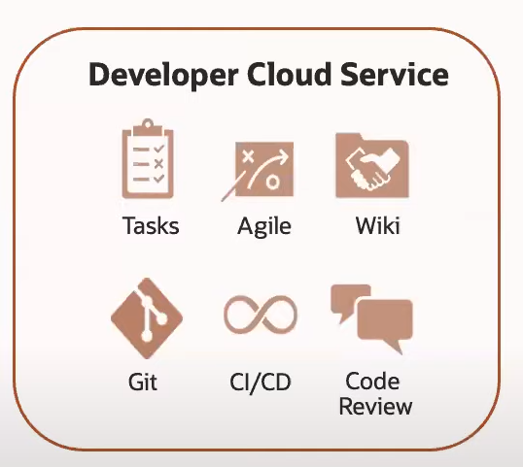
Modern development methodologies
Git Version Management
Development Team Management
CI/CD Automation
Test Driven Development
Browser Debugging Tools
Code Auditing
Deployment Profiles
Covering Full DevOps Cycle

Slide 5
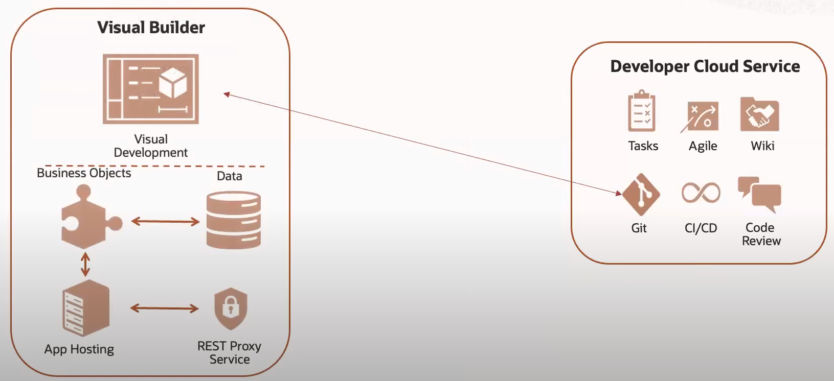
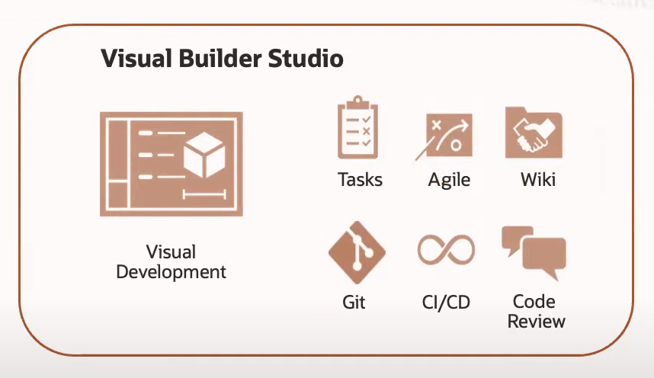
Visual Builder Studio
An integrated development platform that helps your team effectively plan and manage your work throughout the application's lifecycle.
It combines the simplicity of a visual development environment with powerful management tools to streamline application development and deliver modern, innovative user experiences.

Slide 6
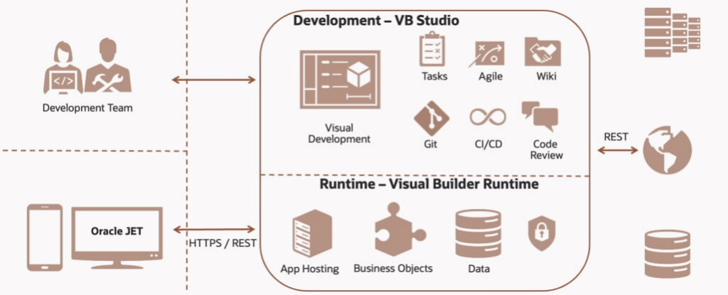
Visual Builder Platform High Level Architecture
Rapidly create, extend, and host enterprise apps using a visual development environment with integrated agile collaborative development, version control, and continuous delivery automation

Slide 7
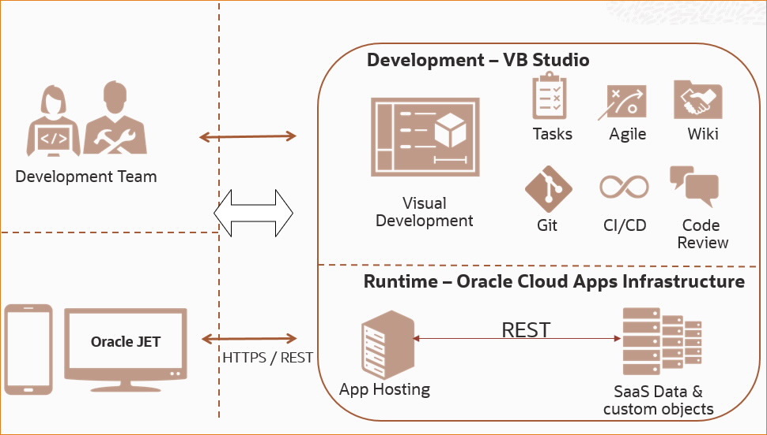
Visual Builder Studio and Oracle Cloud Applications
VBS is also used to deploy applications as app extensions onto the fusion apps runtime.

Slide 8
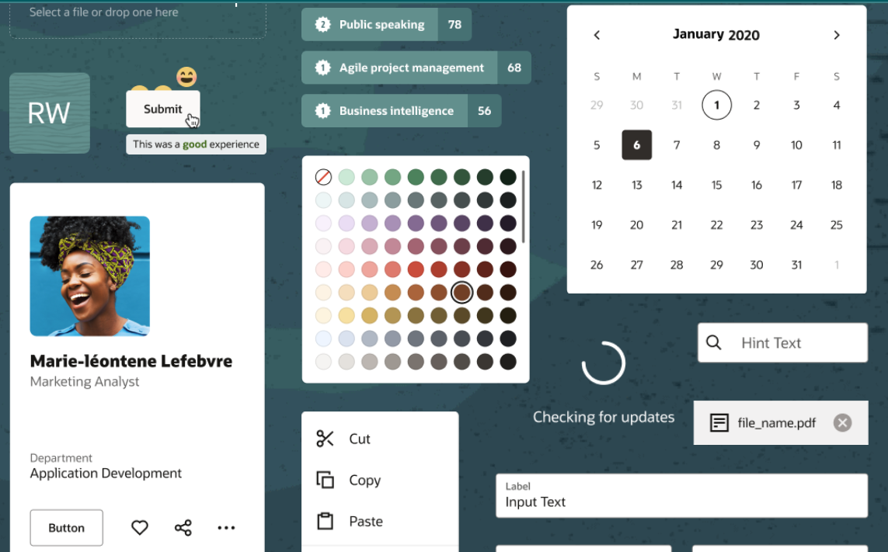
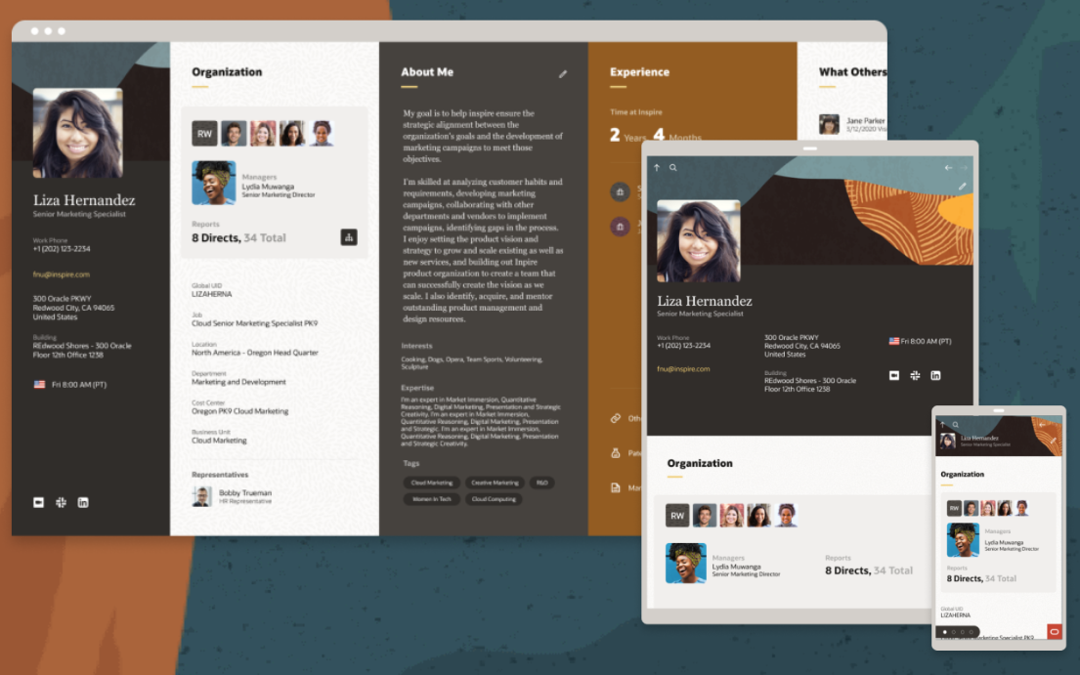
Visual builder studio and redwood design
Oracle Redwood Design is Oracle’s next-generation user experience which brings state-of-art, consumer-grade user experiences across devices to the sophisticated enterprise scenarios that Oracle enables.
Responsive UI Across Devices, Internationalization, Accessibility, Consistency
VBS is deeply integrated with Redwood.

Slide 9
Benefits Of VB Studio
Plan
Code
Build
Test
Release
Deploy
More Git operations
Git tracking panel
Code conflict resolution
Continuous Integration/Continuous Deployment
Deployment Automation across instances
Manage Team members
Track issues
Agile Dashboards
Sprint Planning
Wikis

Slide 10
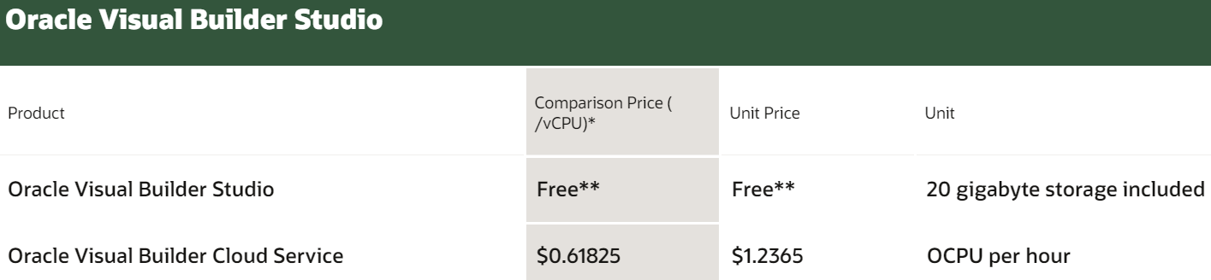
Cost
VB Studio: Design & DevOps – Free
VB: Runtime - Licensed

Slide 11
Summary
VB Studio gives you a better development experience.
Manages deployment across environments/instances.
Enables agile development practices.
Free entitlement.

